Slide 1
BITS Pilani presentation
Amit Dua
Department of Computer Science and Information Systems

Slide 2
CS F212
Database Systems
Lecture No. 2

Slide 3
Till now
Database Systems
Designing database applications
Database approach

Slide 4
Outline
Data Models
Schema
Instances
Three-Schema Architecture
ER Model Basics

Slide 5
Data Models
Concepts that help to describe data types, relationships, and constraints.
High level/conceptual:
  Very close to user
  Entity
  Attribute
  Relationship
  e.g. Entity Relationship model
Low level / physical data model
  How data is stored and organized in storage media
  Access path
  Index

Slide 6
Data Models
Representational/ Implementation
  Easily understood by end user
  Not far from data organization and storage
  Relational data model (network, hierarchical data models)
Object data model
  Higher level implementation model closer to conceptual data model
Self-describing data models
  Schema of data and data combined

Slide 7
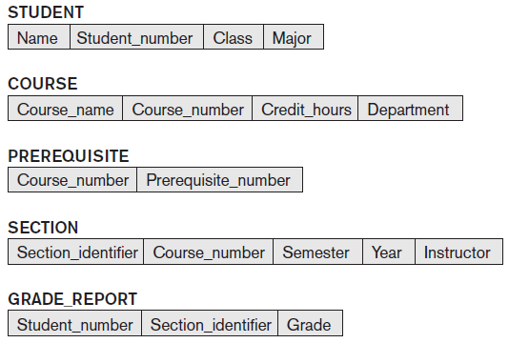
Schema
Description of data: Names of records, data types, constraints

Slide 8
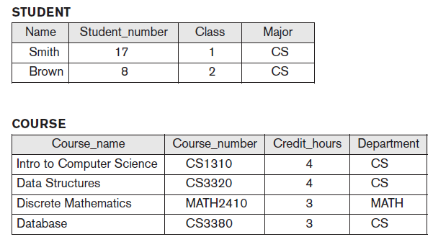
Instance
State satisfying structure and constraints of schema is valid state

Slide 9
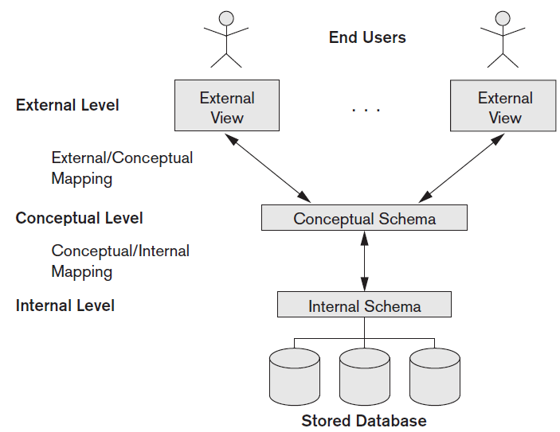
Three-schema architecture

Slide 10
Discussion
What is difference between database schema and database state?

Slide 11
Discussion
What is the need for mapping among schema levels?

Slide 12
Text Book
TB:
Abraham Silberschatz, Henry F Korth and S Sudarshan, Database System Concepts, McGraw Hill, 6th Ed., 2013
R1: Ramez Elmasri & Shamkant B. Navathe, Database Systems; Models, Languages, Design and Application Programming, Pearson Education, 7th Edition, 2017.
Database Design and Applications (CSI ZG518/ SSZG518)

Slide 13
Fun time
www.menti.com
433094

Slide 14
Entity Relationship Model Basics

Slide 15
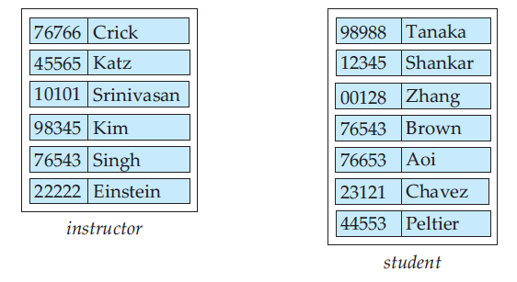
Entities
Entity: any thing or an object. E.g. Amit
Attribute: property that describes entity
  Name and Id number
Entity set: e.g. instructor, student

Slide 16
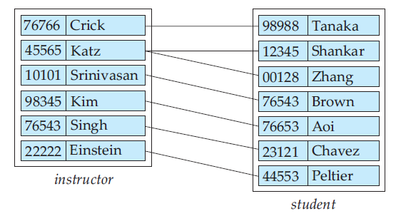
Relationship
Association among several entities.
  Advisor relationship between crick and tanaka
Set of relationships of same type
  E.g. advisor relationship set (set of all different relationships as advisior)

Slide 17
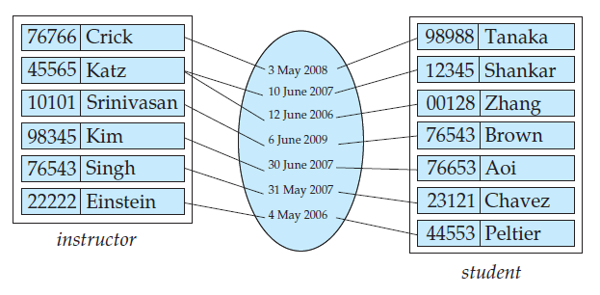
Relationship sets
date as attribute of the advisor relationship set

Slide 18
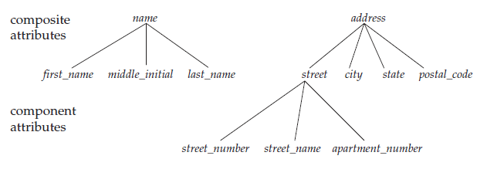
Attributes
Based on subdivision
Simple: No subdivision
  E.g. salary
Composite: With subdivision
  Name (F Name, M Name, L Name)
  Address

Slide 19
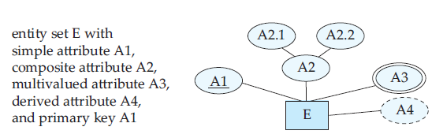
Attributes contd..
Number of values
Single valued
  Date of birth
Multivalued
  Phone number
Stored:
  Date of birth
Derived
  Age

Slide 20
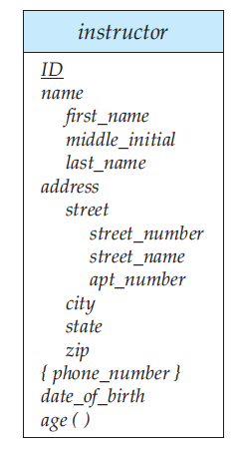
Complex attributes
Complex: multivalued and composite
  More than one address with
  each address having more than one phone

Slide 21
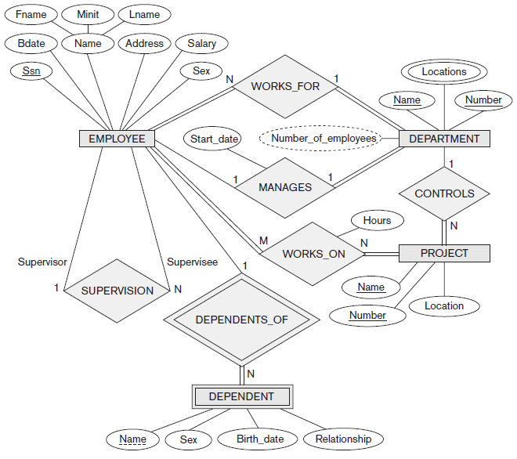

Slide 22
Discussion
What is the type of following attributes for person entity type
Name
Age
Phone number
Address
Date of birth

Slide 23
Discussion
What is the type of following attributes for person entity type
Name: composite, single valued, stored
Age : simple, single valued, derived
Phone number: simple, multi-valued, stored
Address: composite, single valued, stored
Date of birth: simple, single valued, stored

Slide 24
Why Study Databases??
Simply fascinating
  Commercially very relevant !!
DBMS encompasses most of CS
  OS, languages, theory, AI, multimedia, logic
Significance of Databases with Internet
Datasets increasing in diversity and volume.
  Numeric and Textual Databases
  Multimedia Databases
  Geographic Information Systems (GIS)
  Data warehousing, Data mining, Business Intelligence
  Digital libraries, interactive video.
  ... need for DBMS exploding
Database Design and Applications (CSI ZG518/ SSZG518)

Slide 25
Tsunami of Data
Telecom data (≈ 4.6 bn mobile subscribers)
There are 3 Billion Telephone Calls in US each day,
30 Billion emails daily, 1 Billion SMS, IMs.
IP Network Traffic: up to 1 Billion packets per hour per router. Each ISP has many (hundreds) routers!
WWW
Weblog data (160 mn websites)
Email data
Satellite imaging data
Social networking sites data
No. of pics on Facebook
  15 bn unique photos
  60 bn photos stored (4 sizes)
Database Design and Applications (CSI ZG518/ SSZG518)

Slide 26
Big Names in Database Systems
Company Product
Oracle Oracle 8i, 9i, 10g,11g, 12c, 18c
IBM DB2, Universal Server
Microsoft Access, SQL Server-2008
Sybase Adaptive Server
Informix Dynamic Server
Database Design and Applications (CSI ZG518/ SSZG518)

